Slide 1

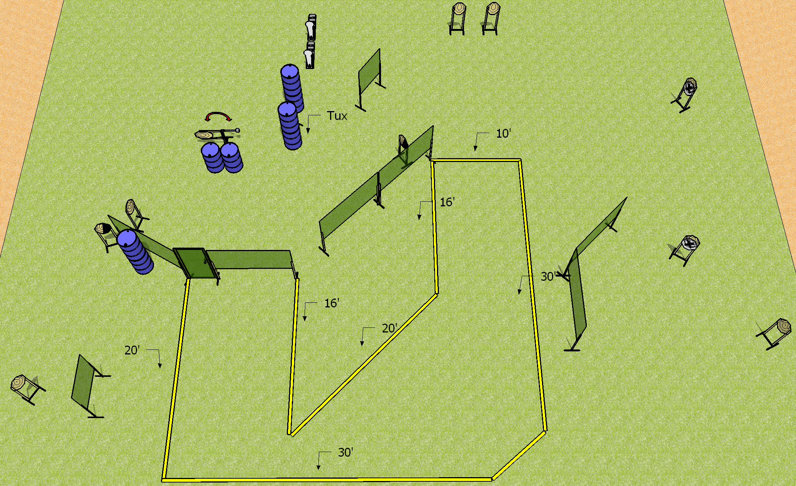
 | Dothan Practical Shooters – USPSA Match Let’s Make a Deal Course Designer : Drew Coleman Bay: B2
Round Count 24 rounds 11 IPSC 2 colt poppers
Equipment List 15 wall feet Door with activator, swinger (swinger will have NS) 11 targets (8 + 3 NS), 1 left + 1 right diag, 1 tux

Slide 2
Let’s Make a Deal
Written Stage Briefing
Scoring: Comstock Rounds: 24
Targets: 11 IPSC, 2 steel
Handgun start position: anywhere inside the shooting area, wrists below belt. Handgun is loaded and holstered.
PCC start position: anywhere inside the shooting area, stock on belt. Loaded carbine is held with both hands, safety on.
Stage Procedure: on the audible start signal, engage targets as they become available from within the shooting area. The swinger is activated by opening the door and remains visible at rest.

